Slide 1
Welcome and Aims of the session
To know what is meant by a ‘Mastery Approach’
Why ‘Mastery?’
How does it work in the classroom? What does it look like?
Introduction to the calculation policy
How can you help your child at home?

Slide 2
Key principles of the mastery approach
Depth before breath; a rigorous and systematic programme that is developed to ensure that every child can achieve excellence.
Deep understanding of concepts through pictorial, concrete and abstract approach (CPA).
Success for all; developing a child’s mindset which is more important than prior attainment.

Slide 3
What does it mean to master Mathematics?
I know how to do it.
It becomes automatic for example I don’t have to think about it (Like driving a car!)
I’m really good at it.
I can show someone else how to do it.

Slide 4
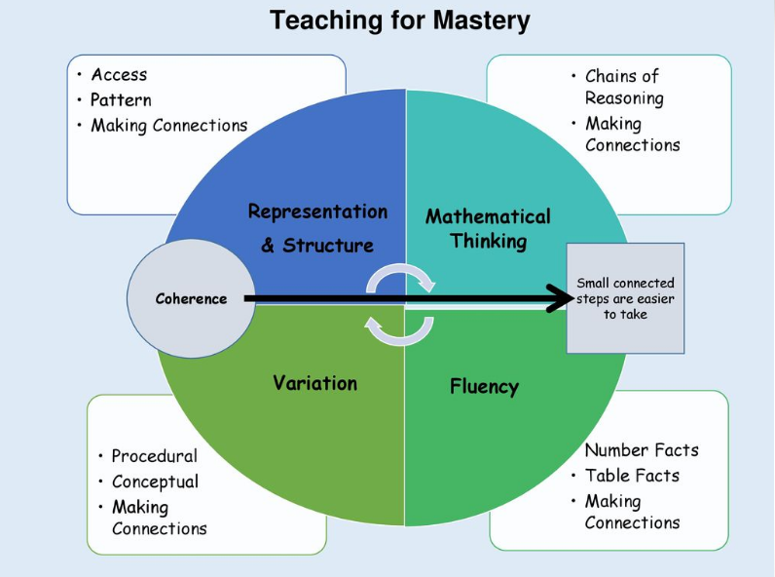
There are 5 big ideas in the Mastery approach: Representation and structure, Mathematical thinking, fluency, variation and coherence.

Slide 5
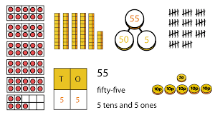

Big idea 1:Representation
Objects, pictures, words, numbers and symbols are everywhere. The Mastery approach helps children to explore and demonstrate mathematical ideas, enrich their learning experience and deepen understanding. Together these elements help cement knowledge so pupils truly understand what they’ve learnt.

Slide 6
Concrete, Pictorial, abstract approach
The mastery approach incorporates all of these to help pupils explore and demonstrate mathematical ideas, enrich their learning experience and deepen understanding.

Slide 7
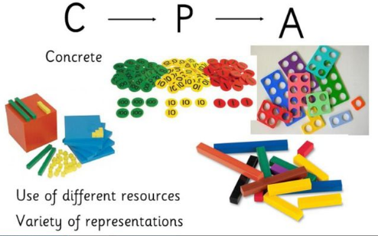
Concrete
Children should have the opportunities to use concrete objects and manipulatives to help them understand and explain what they are doing.
In school we use a variety of apparatus to support this learning such as counters, numicon, bead stings, dienes and objects.

Slide 8
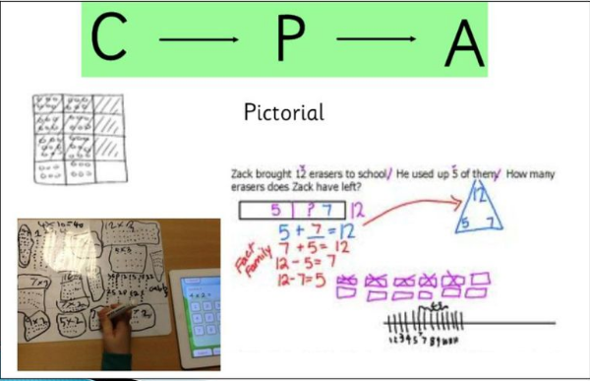
Pictorial
Pupils should then build on this concrete approach by using pictorial representations. These representations can then be used to reason and solve problems.
In school we would use bar models, whole part parts and drawings to show pictorial representations.

Slide 9
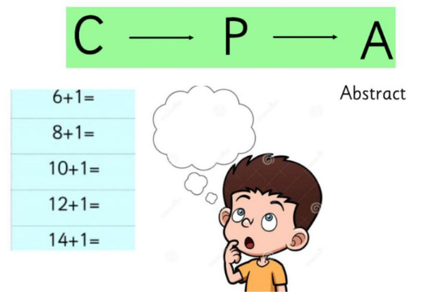
Abstract
With the foundations firmly laid, children should be able to move to an abstract approach using number and key concepts with confidence. Typically, these would be presented in the form of number sentences.

Slide 10
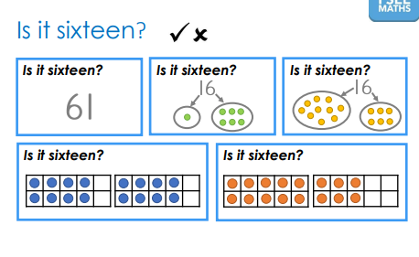
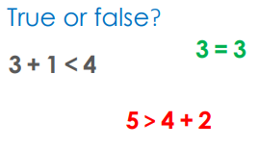
Big Idea 2: Mathematical thinking
Ideas must be thought about, reasoned with and discussed with others.

Slide 11
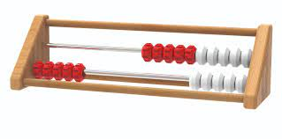
Big Idea 3: Fluency
Quick and efficient recall of fact and procedures and the flexibility to move between different contexts and representations of mathematics.

Slide 12
Big idea 4: Variation
Teachers will vary the way that they present questions to the children. This will either be conceptual or procedurally. Procedural variation allows children to understand the rules of mathematics and apply what they know to solve problems. Conceptual variation is how it is presented to a child. For example showing a number using a range of equipment (numicon, bead string, deienes, counters.)
Variation prevents children recalling instructions and ensures that they are thinking about their maths.

Slide 13
Big idea 5: Coherence
Linking all of these four area together is coherence. The mathematical journey your child takes will be a series of small, connected steps that always gets your child to think as oppose to do.

Slide 14
Maths at Hatch Warren Infant School
We are all on a learning journey together.
Areas are being taught over a longer time with smaller steps of progress.
Differentiation is through deep understanding.
We aim for deep learning.
Children use practical equipment.

Slide 15
Maths at Hatch Warren Infant School
Teachers promote mathematical thinking and reasoning.
Problem solving is crucial to ensuring an understanding of why it works so that the children understand what they are doing rather than routines and procedures.

Slide 16
Year R
Our maths learning is mainly through play and exploration.
Throughout the year, we look at each number to 20 in detail on our working wall. What it means, how to write it and how it can be structured in many different ways. We focus on depth of understanding.
We follow the White Rose small steps and Mastering number programme to increase fluency. Our lessons use practical equipment and we do not record number sentences until later in the year. Our outside area reflects our previous learning so the children can reinforce their learning through play.

Slide 17
Year 1
Our Math is taught building up the children mastery of a concept through each math session in the week
Firstly introducing a new concept, then a practical session with equipment, next pictorial working, possibly involving problem solving and lastly the children can apply this in an abstract way.
During this process will offer the children access to all the equipment they have been taught to use so they can be independent in solving the abstract and to use with problem solving this is how we ensure the children are exposed to variation and can apply their knowledge.
We build up fluency through four sessions a week of Mastering Number and through mental and oral starters in every session.

Slide 18
Year 2
In year 2 we build on the concepts and methods that were covered in year 1 as well as introducing more complex learning. We still use the CPA approach and children are still encouraged to use concrete resources and pictorial representations to consolidate their understanding before moving on to abstract methods.
We spend time developing children’s fluency skills to ensure that they are able to efficiently recall facts and apply them to different areas of their learning. Snappy Maths homework enables children to practise mental recall of crucial facts such as number bonds, doubles, halves, 10 more, 10 less etc.
Problem-solving and Reasoning is another area that we spend a lot of time developing in year 2. Our aim is for children to be able to explain what they are doing and why.

Slide 19
How can you help your child?
Mathematics homework is linked to what is being taught in class. Don’t do the homework for them but take an interest in what they are doing and help them with a concept if they are struggling. Use the calculation policy to help you on the website.
Use every opportunity to ask your child questions to check understanding and to give them opportunities to explain their reasoning.
Look for Maths around you. Telling the time, discussing the days of the week, talking about money or coins, how long things take to cook.
Growth Mindset, help your child to believe that everyone can master Maths given the opportunity.

Slide 20
Calculation policies
Available on the website for each year group.
Shows main areas of teaching for that year group using the CPA approach and key vocabulary.
https://www.pearson.com/content/dam/one-dot-com/one-dot-com/uk/documents/Learner/Primary/Primary%20parents/pearson-maths-mastery-parent-factsheet-final-web.pdf

